Slide 1
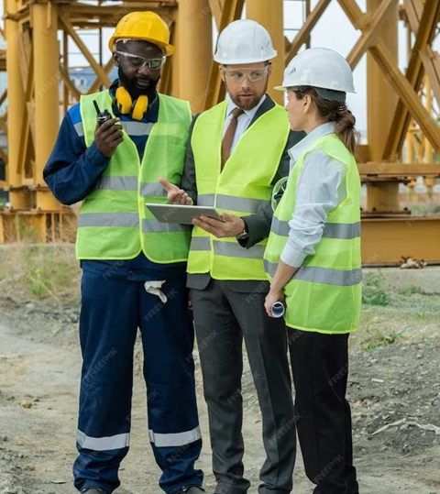
Live Safety Helmet Detection Using Python

Slide 2
AMIT MANDAL 10200321068 PRONAY CHANDRA MRIDHA 10200321055 PAPAI SARKAR 10200321070 SUBHADEEP SAHA 10200320036
PRESENTED BY
UNDER THE GUIDANCE OF DR. BANDANA BARMAN
DATE:-29.05.2024
PAGE- 1

Slide 3

Aim Of The Project
The primary aim of the project is to enhance construction site safety through the implementation of a robust Live Safety Helmet Detection system using CNN, Python, Keras, Tenserflow, OpenCV . The overarching goal is to leverage computer vision technology to automate the monitoring of safety helmet usage among construction site personnel.
PAGE- 2

Slide 4
CONTENT
INTRODUCTION
SOFTWARE AND SIMULATION TOOLS
FLOWCHART
ALGORITHM
DATASET
RESULT
BENEFITS
CHALLENGES
FUTURE SCOPE
CONCLUSION
REFRENCES
PAGE- 3

Slide 5
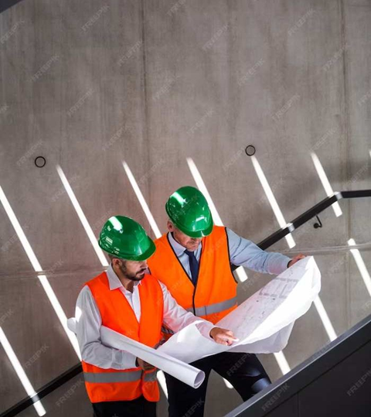
INTRODUCTION
The construction industry, inherently fraught with hazards, necessitates stringent safety measures. Among these, the use of safety helmets stands as a foundational practice to safeguard workers from head injuries. This project delves into the realm of automated safety helmet detection on construction sites, utilizing a synergy of Python programming, Tensorflow, OpenCV, CNN, and the Python, Keras. a dynamic and versatile language, is employed both for coding purposes (Python 3.11) and for model training (Python 3.11). The VS Code IDE, chosen for its simplicity and suitability for educational contexts, provides an accessible environment for coding, ensuring that the project remains pedagogically valuable. OpenCV, renowned for its real-time object detection capabilities, becomes the fulcrum of our live safety helmet detection system.
PAGE- 4

Slide 6
Importance of safety helmets in workplaces
Paramount for protecting employees from accidents, injuries, and occupational hazards.
Head injuries can be severe and even fatal, emphasizing helmet importance.
Compliance with safety protocols enhances productivity and reduces liabilities.
PAGE- 5

Slide 7
Software And Simulation Tools
Python Version 3.11 has used here
VS CODE IDE
Libraries Like Keras , Tenserflow, Numpy and Open CV has used here
Webcam (External)
PAGE- 6

Slide 8
Flowchart
IMPORT MODULE
INITIALIZE IMAGE/VIDEO CAPTURE
CAPTURE FRAME
START
CONVERT TO GRAYSCALE
DETECT FACES
EXTRACT FACE REGION
PREDICT HELMET STATUS
DISPLAY LIVE VIDEO FEED
END
PAGE- 7

Slide 9
Our Approach for Safety Helmet Detection
ALGORITHM
step 1: Install VS Code IDE, Python 3.11, Open CV module, NumPy module, Tenserflow.
step 2: Download the Images and move our main file.
step 3: Download Keras Extension and then train all images in VS CODE
Step 4: Our final code which is used for Live detection includes :
Face Detection: Utilizes Har Cascade Classifier. Identifies faces in the input.
Image Preprocessing: Extracts face region . Resizes and normalizes.
Model Prediction: Utilizes pre-trained CNN. Predicts helmet presence
Visual Feedback: Draws rectangles and labels predictions . Green: Helmet; Red: No Helmet.
.
5) Step 5: Finaly Detecting Safety Helmet on the output Window
PAGE- 8

Slide 10
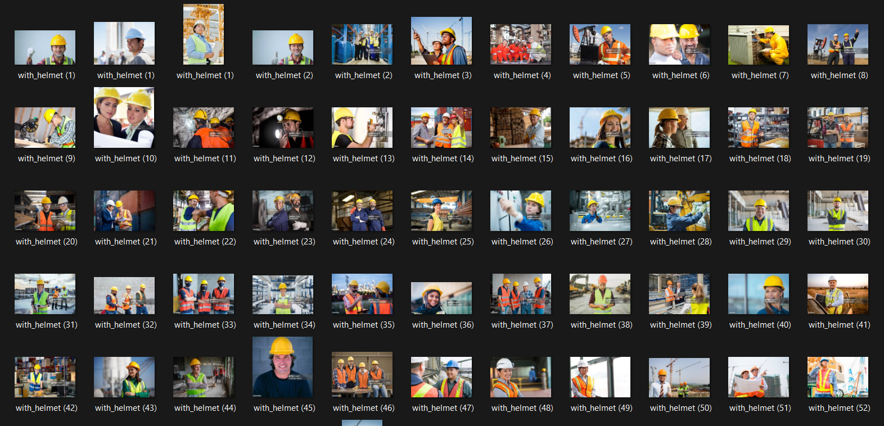
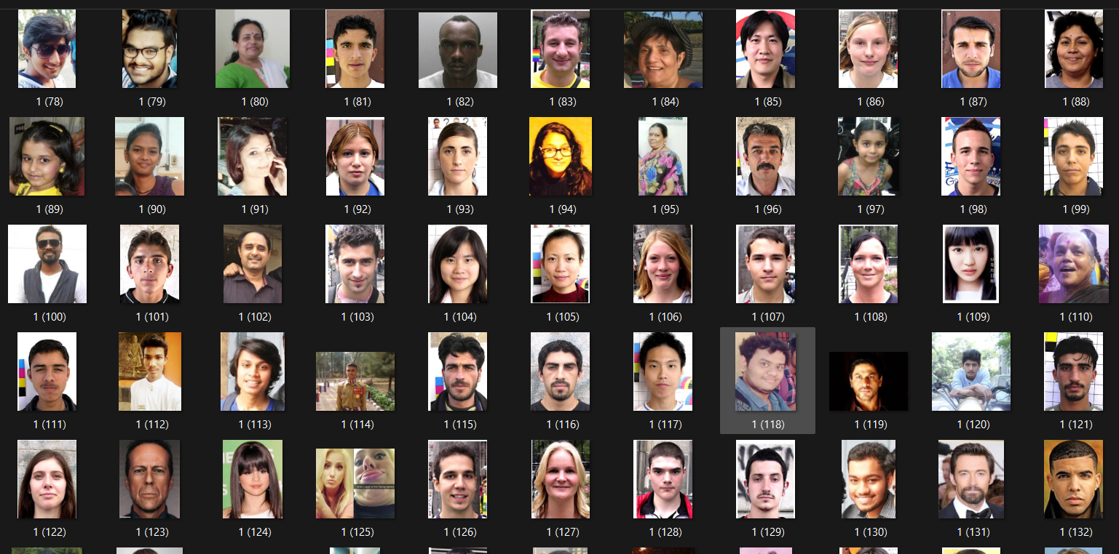
Dataset of with helmet and without helmet
PAGE- 9

Slide 11
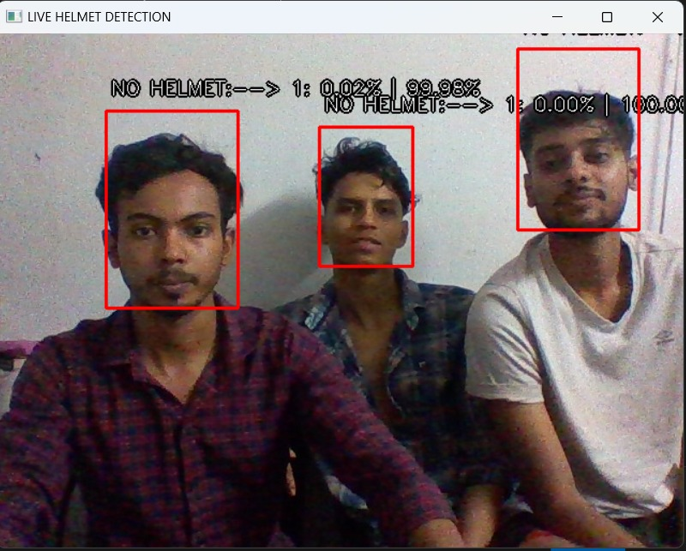
Helmet Detection after the Code Run
OUTPUT
No Helmet
PAGE- 10

Slide 12
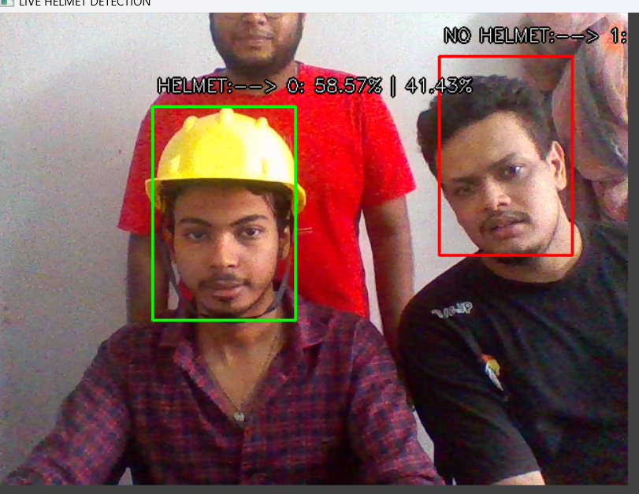
With Helmet
PAGE- 11

Slide 13
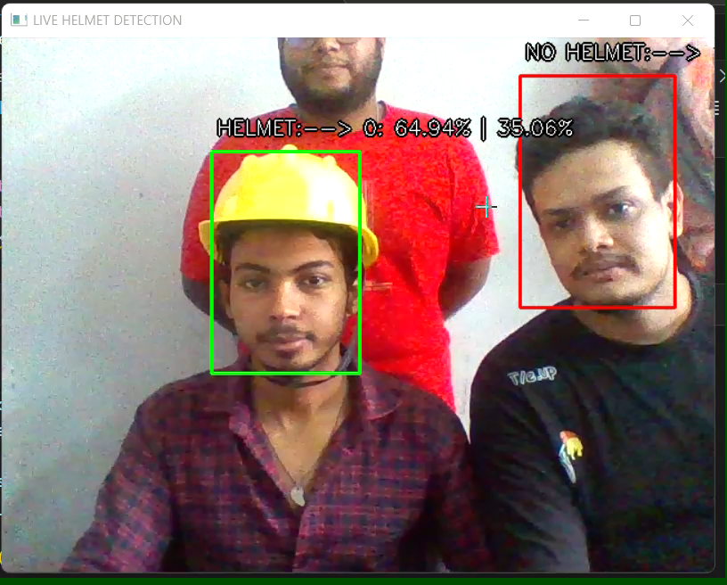
VIDEO OUTPUT
PAGE- 12

Slide 14
Benefits of Safety Helmet Detection System
Enhanced Workplace Safety: Ensures compliance with regulations. Reduces head injuries and fatalities.
Improved Safety Awareness: Raises awareness among workers. Encourages safety culture.
Efficient Safety Enforcement: Enables real-time monitoring. Reduces manual supervision.
Accident Prevention: Identifies and corrects unsafe behavior. Creates a safer work environment.
Cost Savings: Reduces costs associated with accidents. Improves efficiency and productivity.
PAGE- 13

Slide 15
Challenges in Safety Helmet Detection
Variation in Lighting Conditions: Affects visibility.
Occlusion of Faces: Obstructs view of faces.
Helmet Design and Color Variations: Challenges detection.
Real-Time Processing Requirements: Demands efficient algorithms.
Adaptation to Dynamic Environments: Needs to adjust to changes.
False Positives and False Negatives: Minimizing incorrect detections.
PAGE- 14

Slide 16
Future Scope :
1. Industrial Safety: Integration of safety helmet detection into industrial environments to ensure compliance with safety regulations and reduce workplace accidents through automated monitoring systems.
2. Construction Sites: Utilizing safety helmet detection in construction sites to enhance safety measures by automatically identifying workers without helmets and alerting supervisors.
3. Smart Surveillance Systems: Enhancing security measures in public places, industrial facilities, and construction sites by integrating safety helmet detection into smart surveillance systems for quick identification of safety violations.
4. Machine Learning Advancements: Leveraging advancements in machine learning, particularly deep learning, to improve the accuracy and efficiency of safety helmet detection algorithms under various conditions and orientations.
5. IoT Integration: Integrating safety helmet detection with Internet of Things (IoT) devices for real-time monitoring of helmet usage, compliance rates, and detection of impacts or accidents, facilitating proactive safety measures.
PAGE- 15

Slide 17
Conclusion
In conclusion, this project has successfully realized the development and implementation of a Live safety helmet detection system, contributing to the broader goal of improving construction site safety. The automated monitoring system, empowered by CNN algorithm, Python, Keras, Tenserflow, OpenCV, stands as a testament to the intersection of technology and safety. By leveraging these tools, we have created a reliable solution that has the potential to mitigate risks and enhance the well-being of construction site workers.
PAGE- 16

Slide 18
REFERENCES
Zhang, Jiaxiang, et al. "Safety Helmet Detection in Construction Sites." 2018 International Conference on Computer Vision Workshop (ICCVW). IEEE, 2018.
Farooq, Muhammad, and Mamoona Humayun. "Safety Helmet Detection Using Convolutional Neural Networks." International Journal of Computer Science and Network Security 19.2 (2019): 105-110.
Chen, Xiongyu, et al. "Real-time Helmet Detection and Head Orientation Estimation." 2018 13th IEEE Conference on Industrial Electronics and Applications (ICIEA). IEEE, 2018.
Wei, Shuhang, et al. "Research on Helmet Detection Technology in Coal Mines Based on Machine Vision." 2019 IEEE 5th International Conference on Computer and Communications (ICCC). IEEE, 2019.
Zeng, Wenping, et al. "Study on the Application of Computer Vision Technology in the Safety Helmet Detection of Construction Workers." 2019 2nd International Conference on Electrical Engineering and Green Energy (CEEGE). IEEE, 2019.
Chen, Chen, et al. "Helmet Detection in Construction Sites Based on Improved YOLOv3." 2019 IEEE 8th Joint International Information Technology and Artificial Intelligence Conference (ITAIC). IEEE, 2019.
Zhang, Qi, et al. "A Safety Helmet Detection Method Based on Faster R-CNN." 2020 IEEE 5th International Conference on Signal and Image Processing (ICSIP). IEEE, 2020.
Liu, Pengfei, et al. "Research on Safety Helmet Detection Algorithm Based on YOLOv3 Model." 2020 IEEE 6th International Conference on Computer and Communications (ICCC). IEEE, 2020.
Wang, Lei, et al. "Safety Helmet Detection Based on Improved YOLOv3 Algorithm." 2020 International Conference on Cyber Security Intelligence and Analytics (CSIA). IEEE, 2020.
Yang, Yaxing, et al. "Safety Helmet Detection Based on Faster R-CNN and Single Shot MultiBox Detector." 2021 International Conference on Artificial Intelligence in Information and Communication (ICAIIC). IEEE, 2021.

Slide 19
Thanks!

